Slide 1
Data Wrangling – Part 1
January 10, 2018

Slide 2
Agenda – Welcome to 2018!
Sara & John from Tek Systems
  Northern CO DS Opportunities
  Our pizza sponsors – THANK YOU!
Michael – Stabel Geniuses everywhere…
Michael – Data Wrangling: SQL and basic dplyr

Slide 3

Geniuses

Slide 4
Geniuses
..."I went from VERY successful businessman, to top T.V. Star..…"
"....to President of the United States (on my first try). I think that would qualify as not smart, but genius....and a very stable genius at that!"
@realDonaldTrump
January 6, 2018

Slide 5

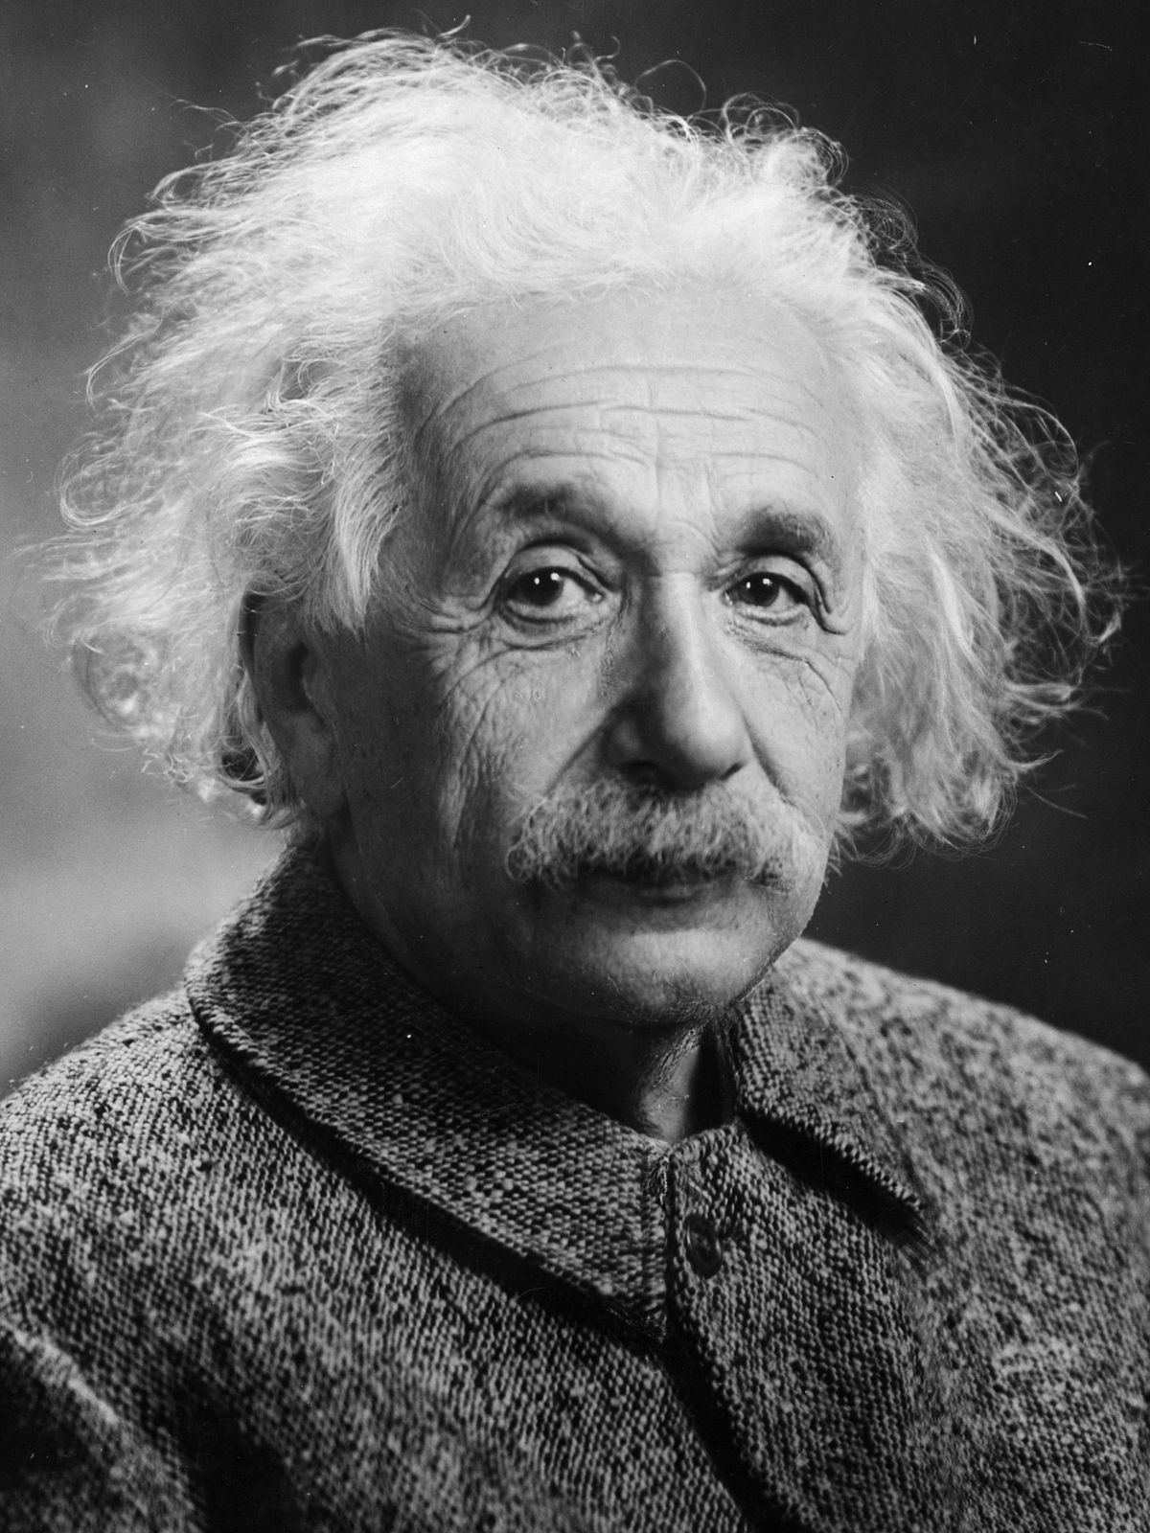
Geniuses
… then there are other stable geniuses...
… that don‘t have to tell us they are a genius.

Slide 6
But what if you‘re not stable or a genius?

Slide 7

But what if you‘re not stable or a genius?

